Slide 1

Hypothesis Testing
Abdullah Qayyum

Slide 2
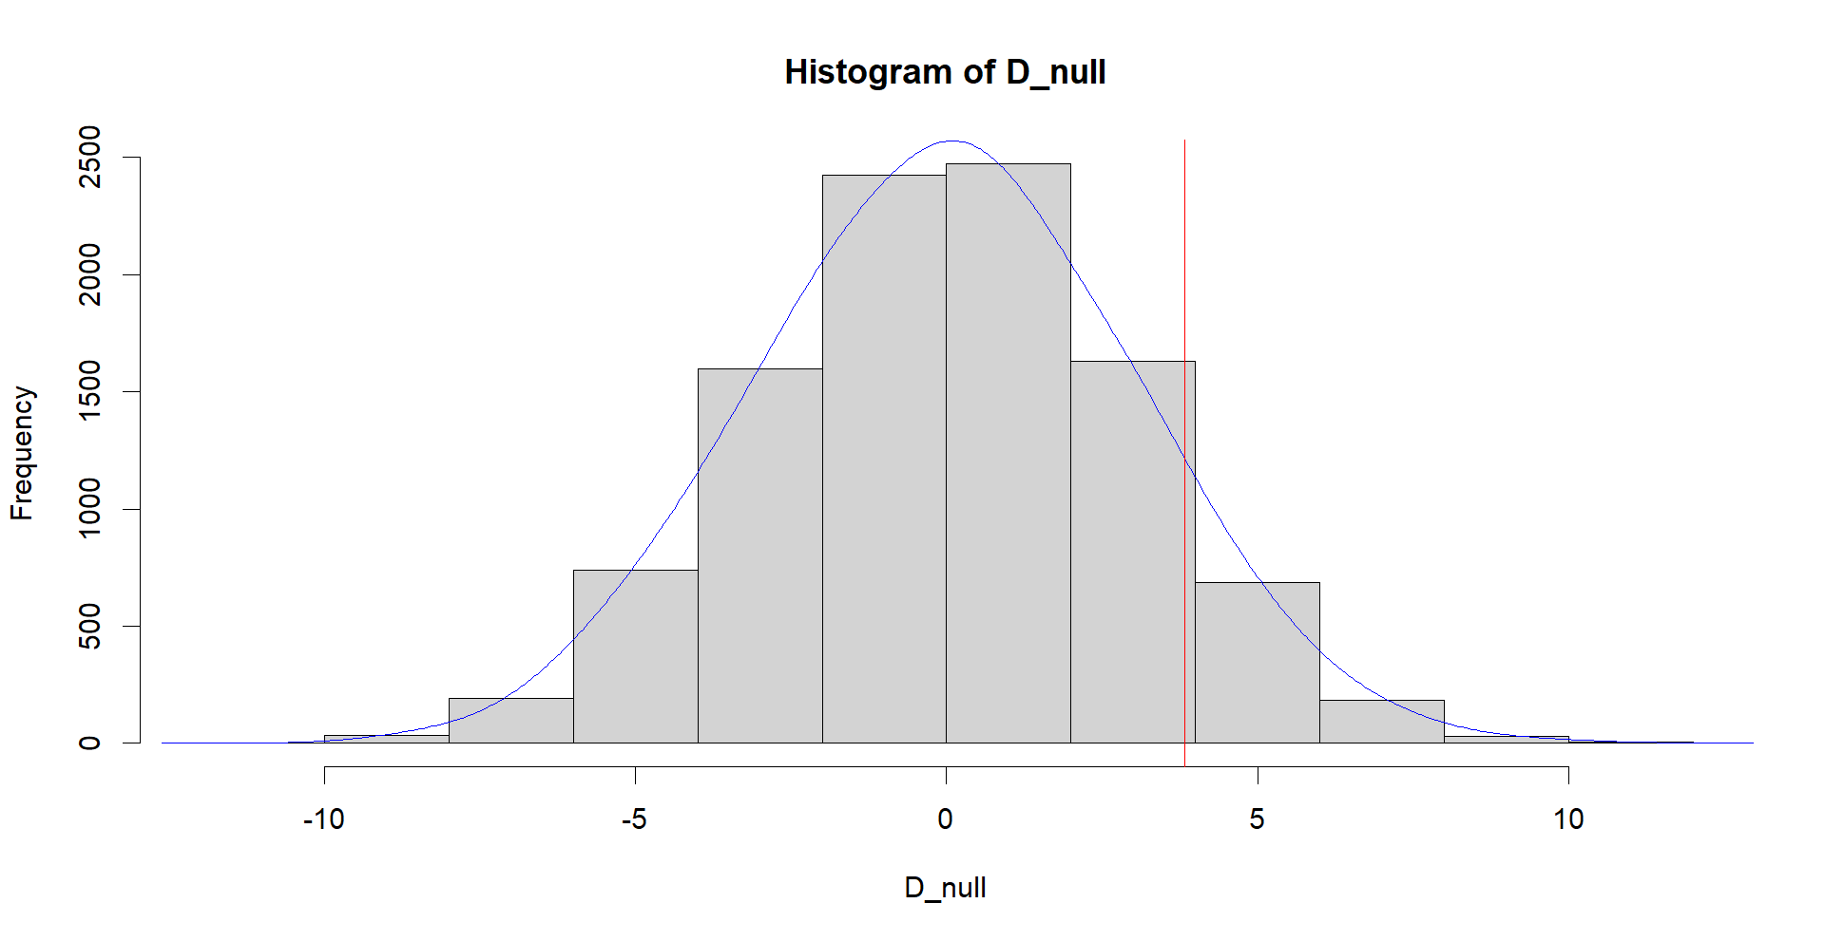
Hypothesis 1(C)
Alternative Hypothesis: We initially thought that the average attendance at Hip-Hop parties is higher on Fridays compared to Thursdays.
Null Hypothesis: On the other hand, we considered the possibility that there is no meaningful difference in the average attendance at Hip-Hop parties between Thursdays and Fridays.
After conducting a Permutation Hypothesis Test, we obtained a p-value of 0.0981.
Since the p-value is greater than the commonly used threshold of 0.05, this means that the evidence provided by our data is not strong enough to dismiss the null hypothesis in favor of the alternative hypothesis. In simpler terms, we don't have sufficient statistical support to claim that more people attend Hip-Hop parties on Fridays compared to Thursdays.

Slide 3
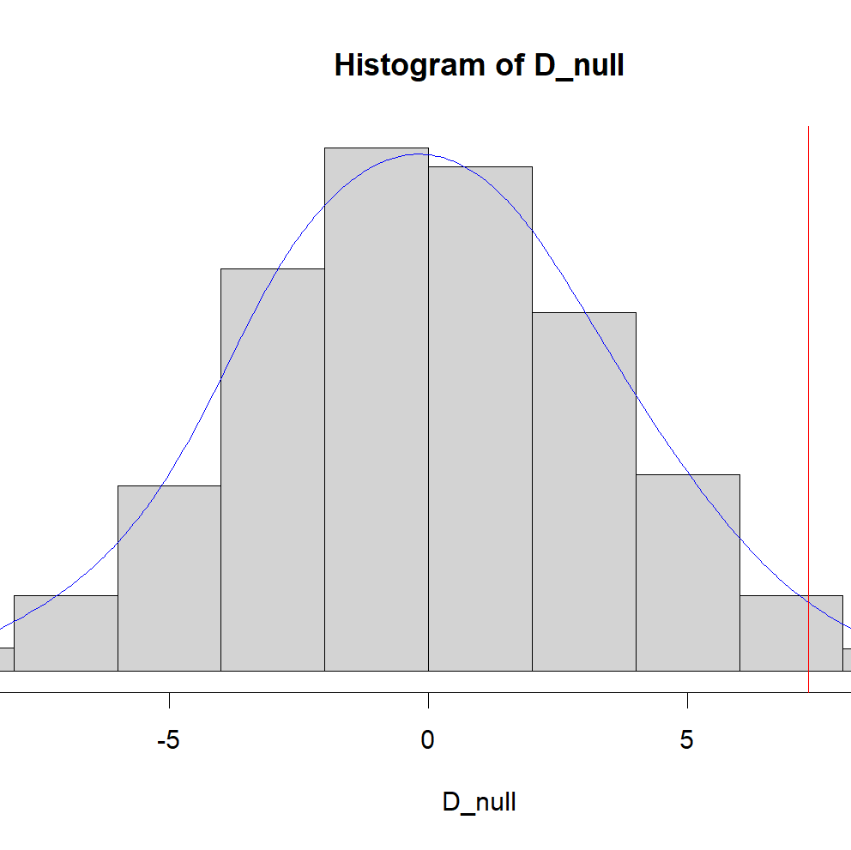
Hypothesis 2(B)
Alternative Hypothesis: Initially, we hypothesized that the average attendance at DJ Blue's Friday party is higher than the average attendance at DJ Alex's Friday party.
Null Hypothesis: As an alternative scenario, we considered that there is no meaningful difference in the average attendance between DJ Blue's and DJ Alex's Friday parties.
After conducting a Permutation Hypothesis Test, we obtained a p-value of 0.0181.
Given that the p-value is less than the conventional significance level of 0.05, this provides us with enough statistical evidence to reject the null hypothesis. In simpler terms, we have solid data-based support to conclude that the mean attendance at DJ Blue's Friday party is indeed higher than the mean attendance at DJ Alex's Friday party.

Slide 4
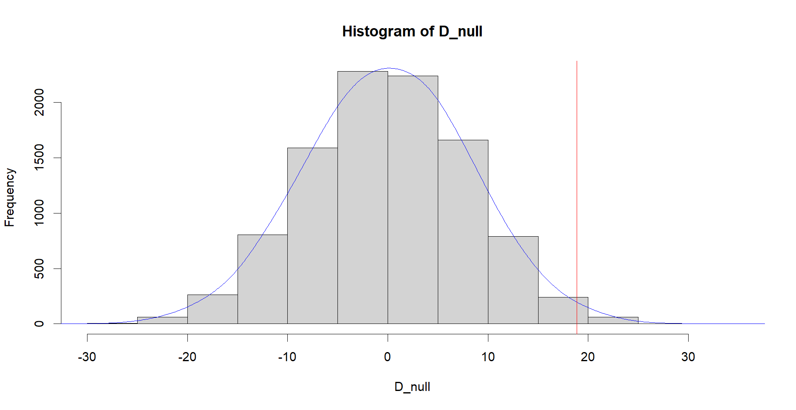
Hypothesis 3(A)
Alternative Hypothesis: Our initial hypothesis was that the average attendance for Hip-Hop music played by DJ Carol on Saturdays is lower than the average attendance for Hip-Hop music played by DJ Ania on Saturdays.
Null Hypothesis: As an alternative scenario, we entertained the idea that there is no meaningful difference in the average attendance for Hip-Hop music played by DJ Carol and DJ Ania on Saturdays.
Upon conducting a Permutation Hypothesis Test, the resulting p-value was 0.0092.
Since the p-value is less than the commonly used significance level of 0.05, we now have strong statistical evidence to reject the null hypothesis. In simpler terms, the data supports the conclusion that the average attendance for Hip-Hop music played by DJ Carol on Saturdays is indeed lower than the average attendance for Hip-Hop music played by DJ Ania on Saturdays.

Slide 5
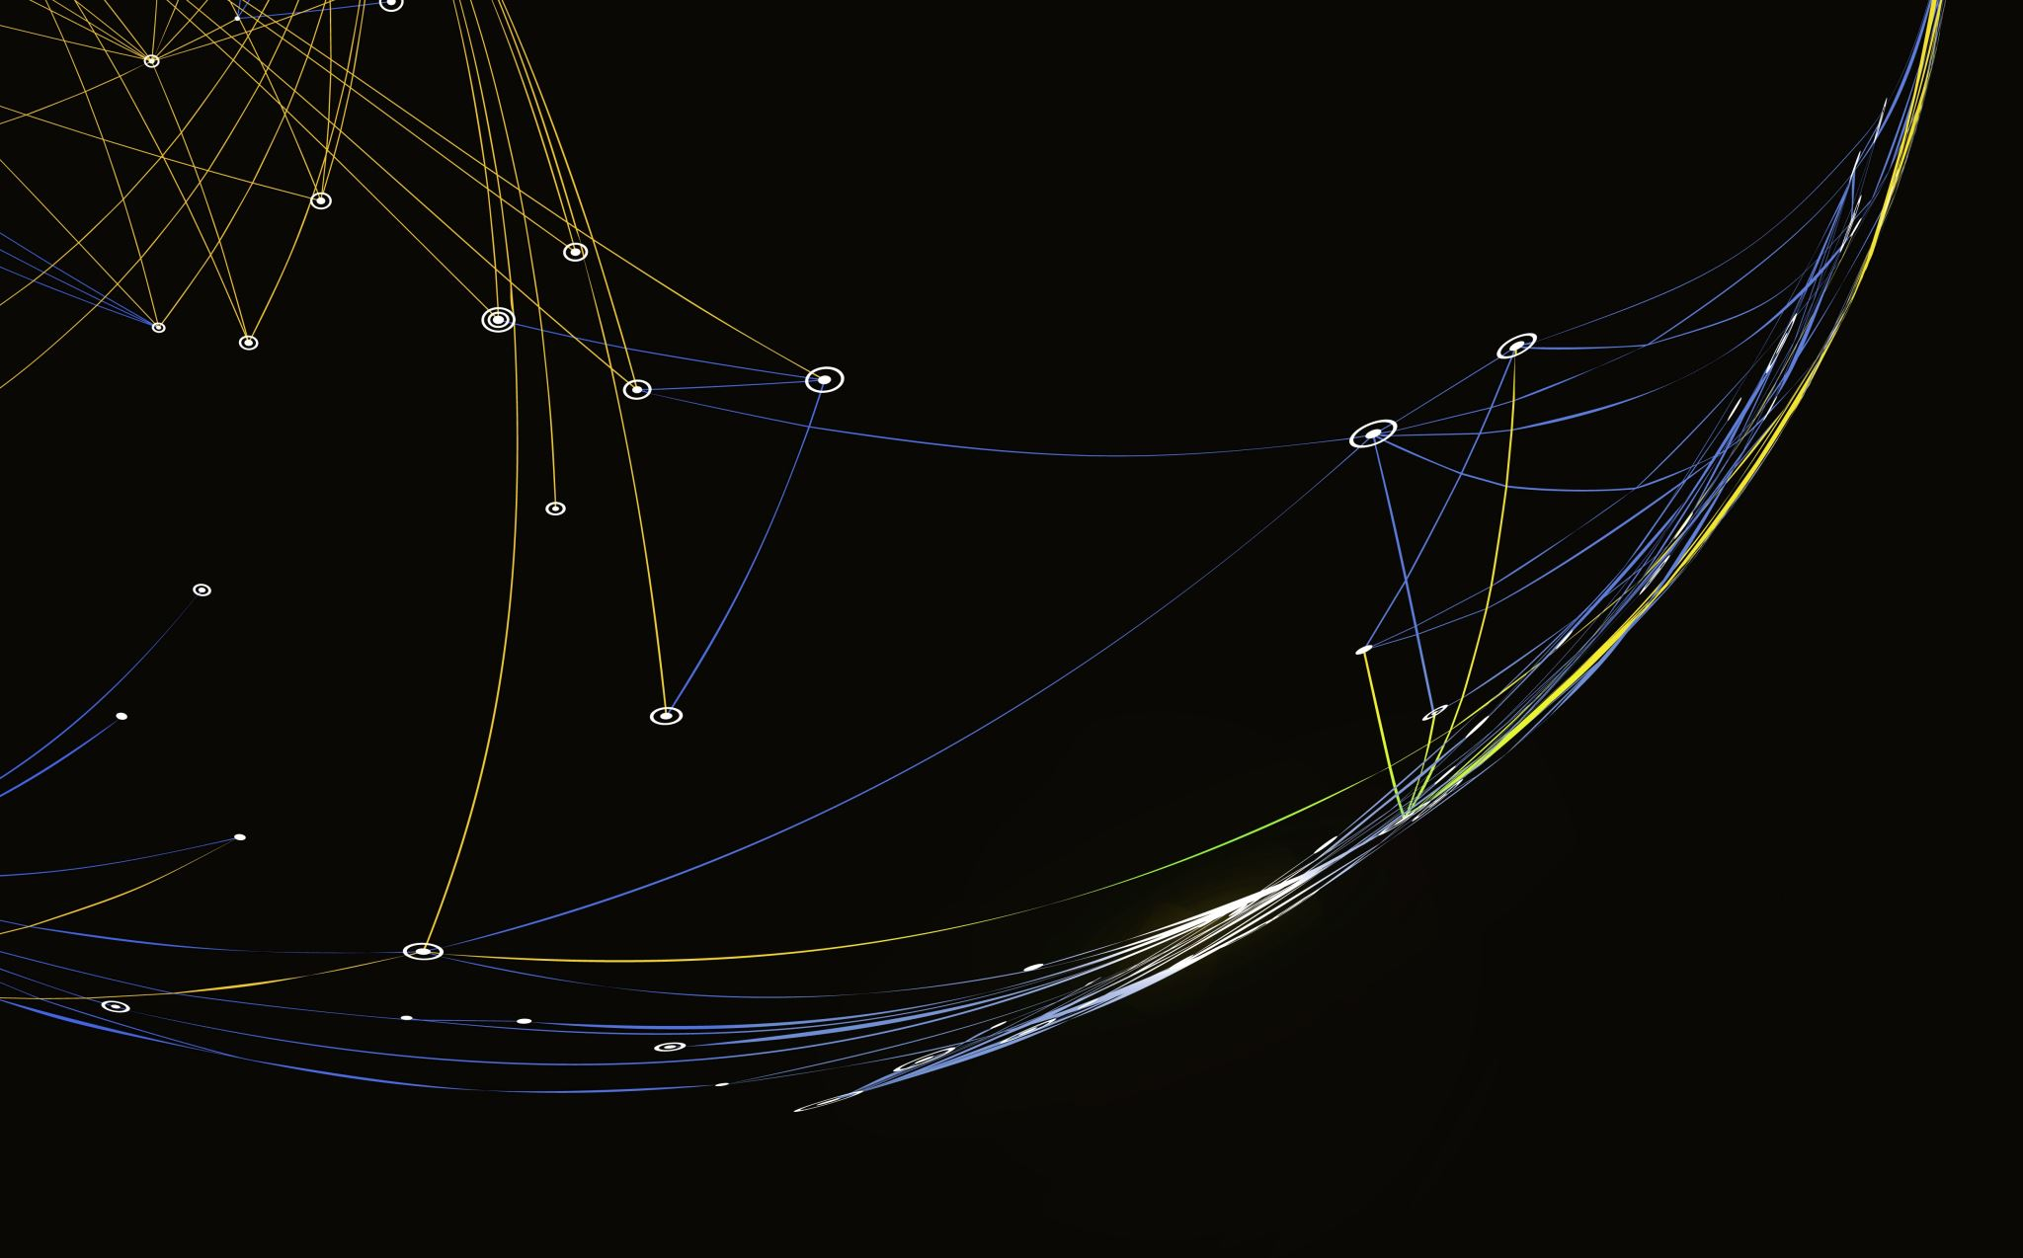
The End

